Slide 1

University Admit Eligibility Predictor
ML_C03TEAM : CSE_AIML_C03
USING IBM WATSON

Slide 2
18481A05D3 – M. Sai Sathwika 18481A05C1 – K. Anjani Varsha 18481A05H5 – P. Sandhya 19485A0524 – K. Venkata Durga
TEAM : CSE_AIML_C03

Slide 3
1. INTRODUCTION 2. LITERATURE SURVEY 3.THEORITICAL ANALYSIS 4. EXPERIMENTAL INVESTIGATIONS 5. FLOW CHART 6. RESULT 7. ADVANTAGES 8. DISADVANTAGES 9. APPLICATIONS 10. CONCLUSION 11. FUTURE SCOPE 12. BIBILOGRAPHY 13. APPENDIX
index

Slide 4
Students are often worried about their chances of admission to University. The aim of this project is to help students in shortlisting universities with their profiles. The predicted output gives them a fair idea about their admission chances in a particular university. This analysis should also help students who are currently preparing or will be preparing to get a better idea.
Introduction

Slide 5
1. Defining our classification categories 2. Importing the dataset 3. Train the model 4. Test our model
Overview

Slide 6
To complete this project, we need to install the following packages: 1.Numpy: This package is used to perform numerical computations. This package is pre-installed in anaconda. 2.Pandas: Pandas is one of the most widely used python libraries in data science. It provides high-performance, easy to use structures, and data analysis tools. This package is pre-installed in anaconda. 3.Matplotlib: Matplotlib is a comprehensive library for creating static, animated, and interactive visualizations in Python. This package is pre-installed in anaconda. 4.Scikit-learn: This is a machine learning library for the Python programming language. This package is pre-installed in anaconda. 5.Flask: Flask is a lightweight WSGI web application framework.
Literature survey

Slide 7
If not installed use the following Open anaconda prompt as administrator. Type “pip install numpy” and click enter. Type “pip install pandas” and click enter. Type “pip install matplotlib” and click enter. Type “pip install scikit-learn” and click enter. Type “pip install Flask” and click enter.
The above steps allow you to install the packages in the anaconda environment.

Slide 8
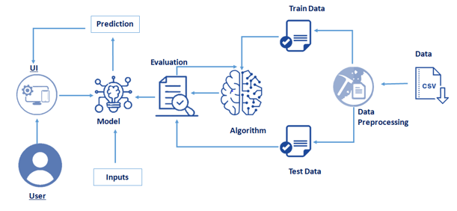
Block Diagram
THEORITICAL ANALYSIS

Slide 9
Numpy- It is an open-source numerical Python library. It contains a multi-dimensional array and matrix data structures. It can be used to perform mathematical operations on arrays such as trigonometric, statistical, and algebraic routines. Pandas- It is a fast, powerful, flexible and easy to use open-source data analysis and manipulation tool, built on top of the Python programming language. Seaborn- Seaborn is a Python data visualization library based on matplotlib. It provides a high-level interface for drawing attractive and informative statistical graphics. Matplotlib- Visualisation with python. It is a comprehensive library for creating static, animated, and interactive visualizations in Python.
Experimental investigations

Slide 10
Data collection
Data Preprocessing
Model Building
Application Building
Flow chart

Slide 11
Collect the dataset or create the dataset
Data collection

Slide 12
Import the Libraries. Importing the dataset. Checking for Null Values. Data Visualization. Taking care of Missing Data. Label encoding. One Hot Encoding. Feature Scaling. Splitting Data into Train and Test.
Data Preprocessing

Slide 13
Training and testing the model Evaluation of Model
Model Building

Slide 14
Create an HTML file Build a Python Code
Application building

Slide 15
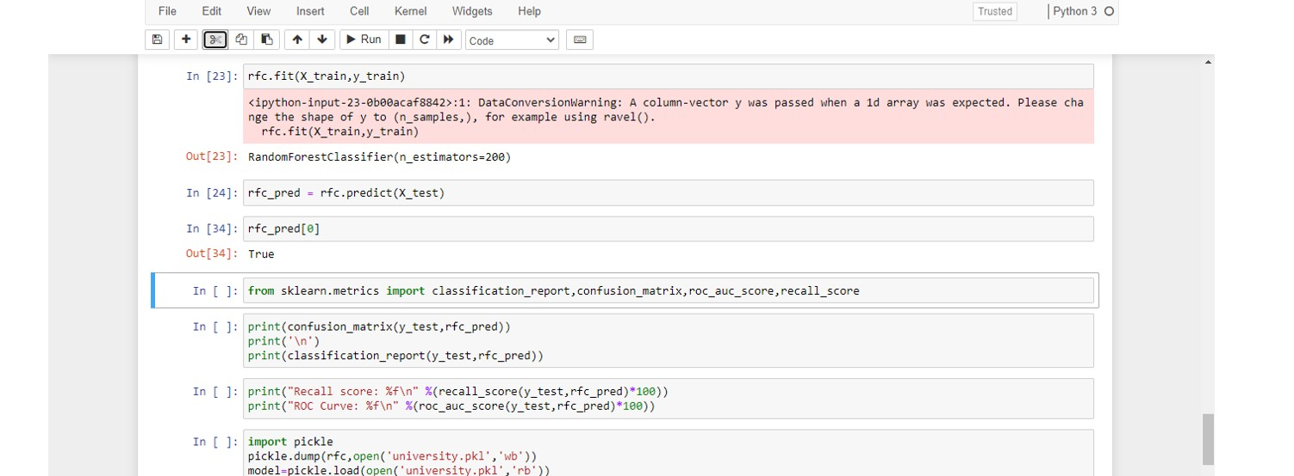
RESULT

Slide 16
It reduces overfitting in decision trees and helps to improve the accuracy. It is flexible to both classification and regression problems. It works well with both categorical and continuous values. It automates missing values present in the data.
Advantages

Slide 17
If there are enough trees in the forest, the classifier won't overfit the model. The main limitation of random forest is that a large number of trees can make the algorithm too slow and ineffective for real-time predictions.
disadvantages

Slide 18
Banking Industry Health Care and Medicine E-Commerce Stock Market
Applications

Slide 19
By the end of this project you’ll be able to understand : Regression and Classification Problems To grab insights from data through visualization. Applying different algorithms according Evaluation metrics how to build a web application using the Flask framework.
conclusion

Slide 20
Random forest algorithm generates many classification trees and generation of each tree is independent of each other. Thus, Random Forest is by nature a suitable candidate for parallel processing. Additionally, data mining is usually performed on very large datasets, and Random Forest can work well on datasets with large number of predictors. As mentioned , each parallel implementation of Random Forest is specific to some platform or language. Thus, there is scope for generalized Parallel Algorithm for Random Forest. With the geographical spread of business and the world getting connected with the Internet; business data is distributed at different locations. Hence, design of Distributed Random Forest algorithm is another important future research direction.
Future Scope

Slide 21
We used dataset from kaggle website to train the model. https://www.kaggle.com/rishal005/admission-predict We saw some reference videos in you tube. https://www.youtube.com/watch?v=TysuP3KgSzc&t=4s https://www.youtube.com/watch?v=ST1ZYLmYw2U
bibilography

Slide 22
a. Source code b. UI Output Screenshots
appendix

Slide 23
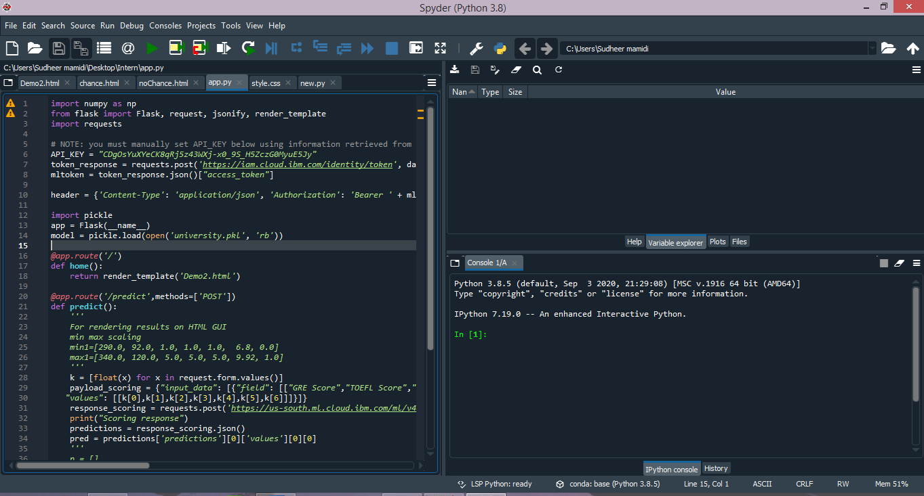
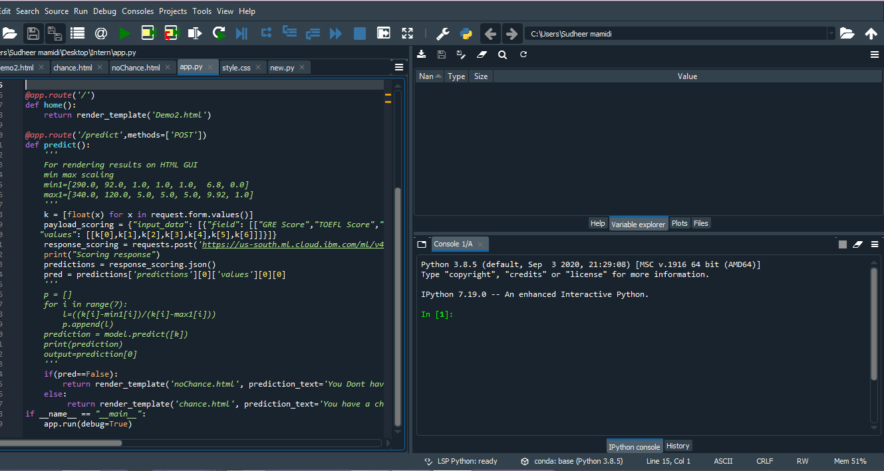
Source code

Slide 24
SCREEN SHOTS

Slide 25

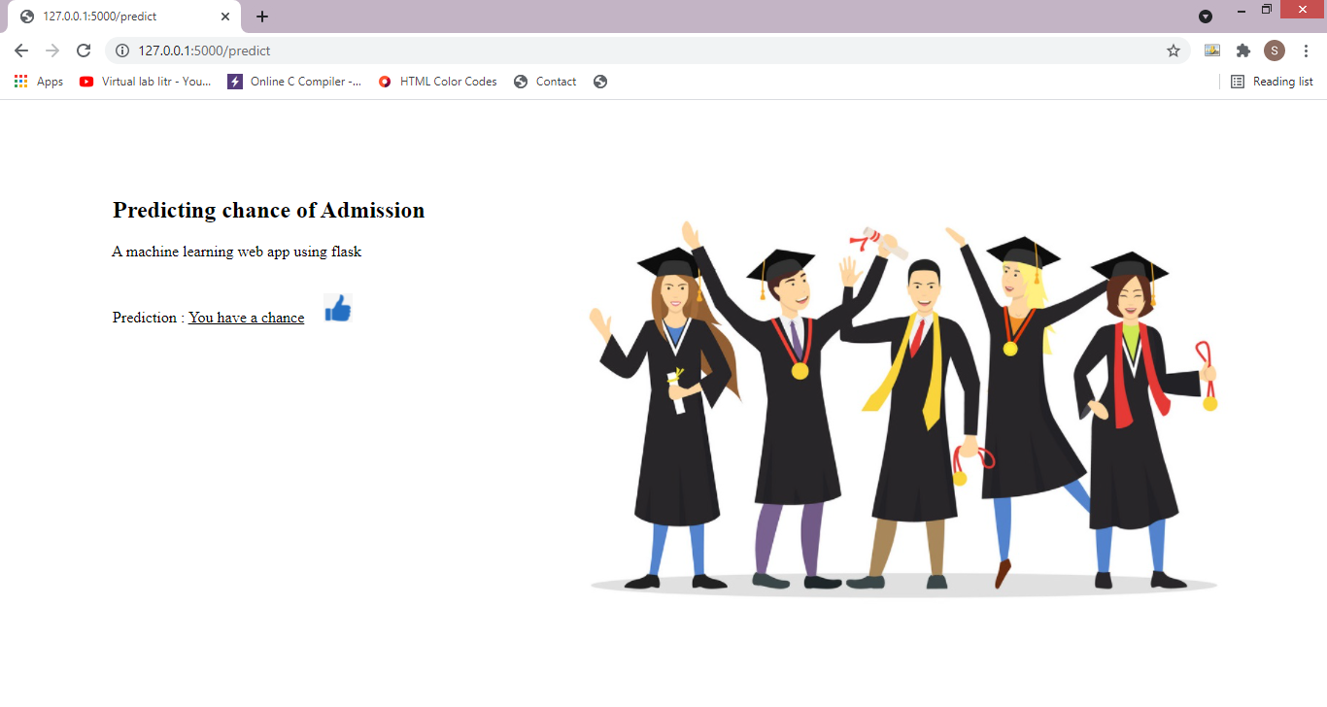
Having Chance to Admit

Slide 26

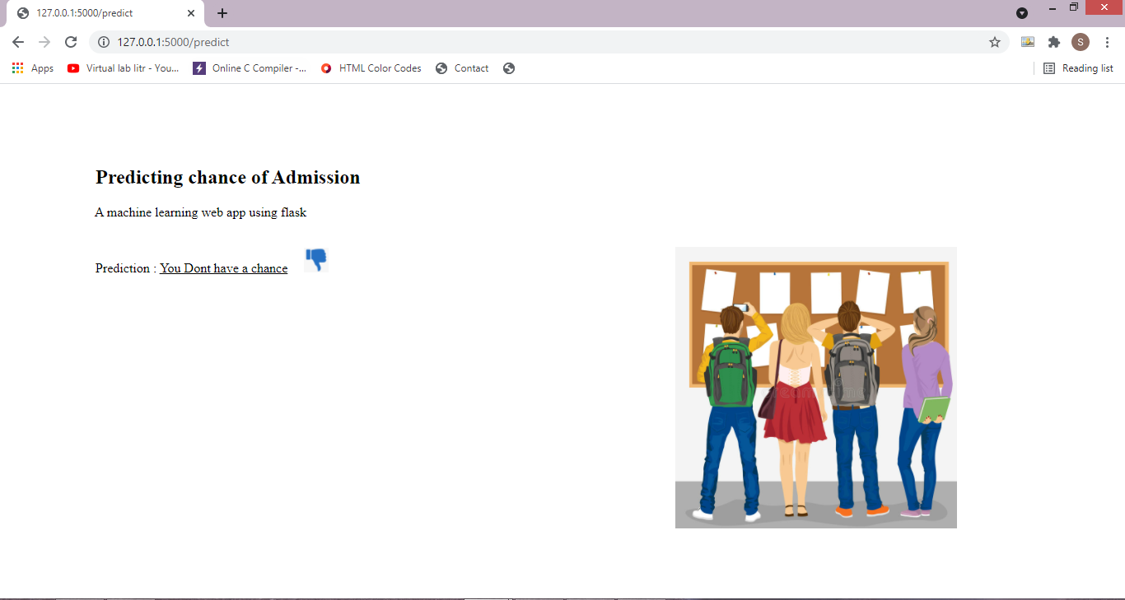
No Chance to Admit

Slide 27
QUERIES ???
Thank you

